Slide 1

Introducing spreadsheets
Lesson 2: Functions using SUM, AVERAGE, MAX and MIN

Slide 2
Objectives
Lesson 2: Functions using SUM, AVERAGE, MAX and MIN
In this lesson you will learn how to:
write functions to:
  add up the values in a range of cells
  find the average of a set of values
  find the largest value in a range of cells
  find the smallest value in a range of cells.
choose the appropriate function to complete a task.

Slide 3
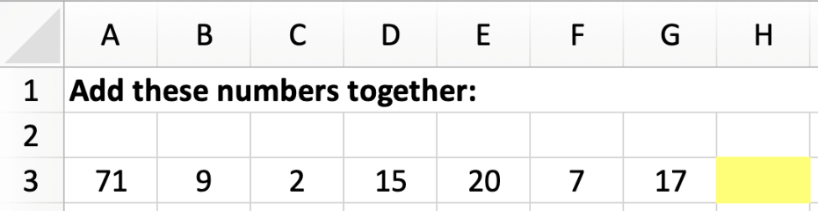
Using a formula
Lesson 2: Functions using SUM, AVERAGE, MAX and MIN
In cell H3, you could use the formula:
=A3+B3+C3+D3+E3+F3+G3

Slide 4
Functions
Lesson 2: Functions using SUM, AVERAGE, MAX and MIN
Functions are pre-programmed into spreadsheets.
They allow us to perform longer or more complex calculations with ease.
Today, we will be concentrating on four functions:
SUM, AVERAGE, MAX, and MIN.

Slide 5
Using a function
Lesson 2: Functions using SUM, AVERAGE, MAX and MIN
All functions start with an equals sign = followed by the function name.
The data to be used by the function is referenced using individual cell references or a cell range enclosed within parentheses ( ).
For example:
=SUM(A3:G3)
This function will add together the values in the cell range A3 to G3.
Cell range
=A3+B3+C3+D3+E3+F3+G3
Function name

Slide 6
How to write a function in Excel:
Lesson 2: Functions using SUM, AVERAGE, MAX and MIN
Find the cell where to write a function
Write =
Write name of the function with parenthesis
Write cell range enclosed within parentheses
= SUM(A3:G3)

Slide 7
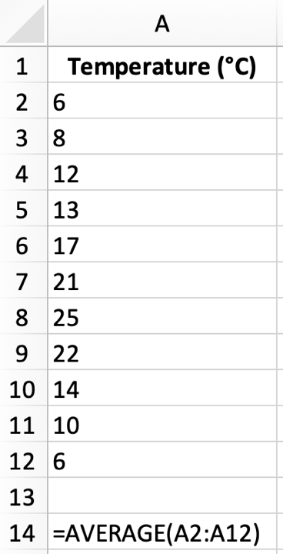
Using a function
Lesson 2: Functions using SUM, AVERAGE, MAX and MIN

Slide 8
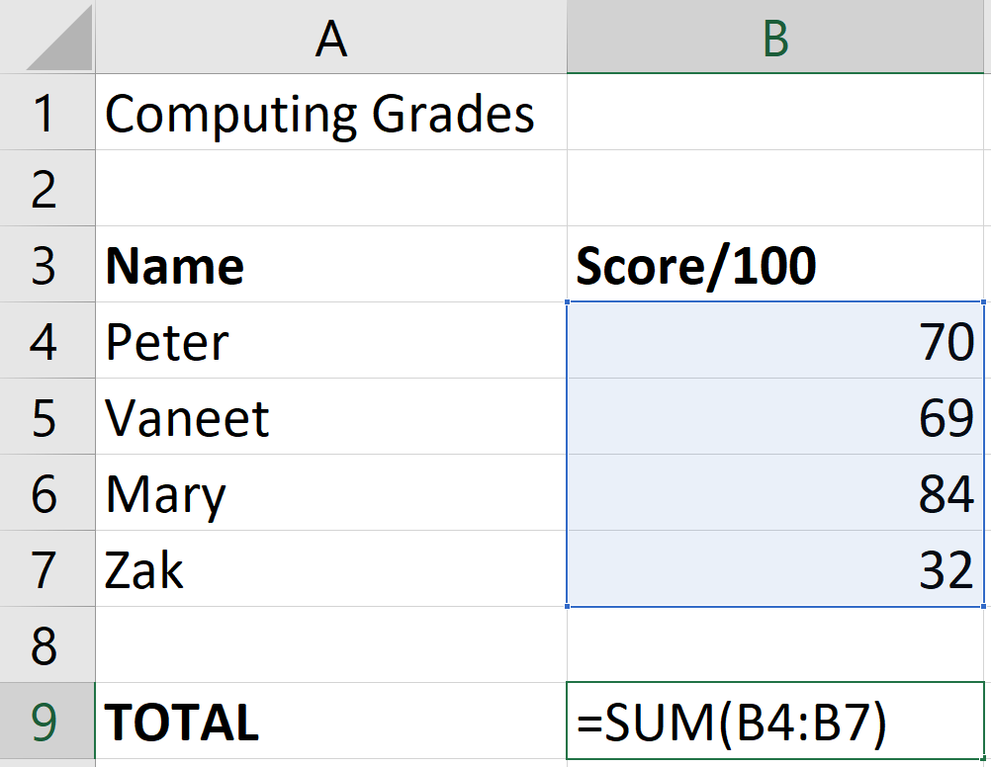
The SUM function
Lesson 2: Functions using SUM, AVERAGE, MAX and MIN
The SUM function adds up the values in a range of cells.
To add up the total score for the group use the formula: =SUM(B4:B7).
Now watch video 2.1

Slide 9

Activity 2.1: Using SUM
Lesson 2: Functions using SUM, AVERAGE, MAX and MIN

Slide 10
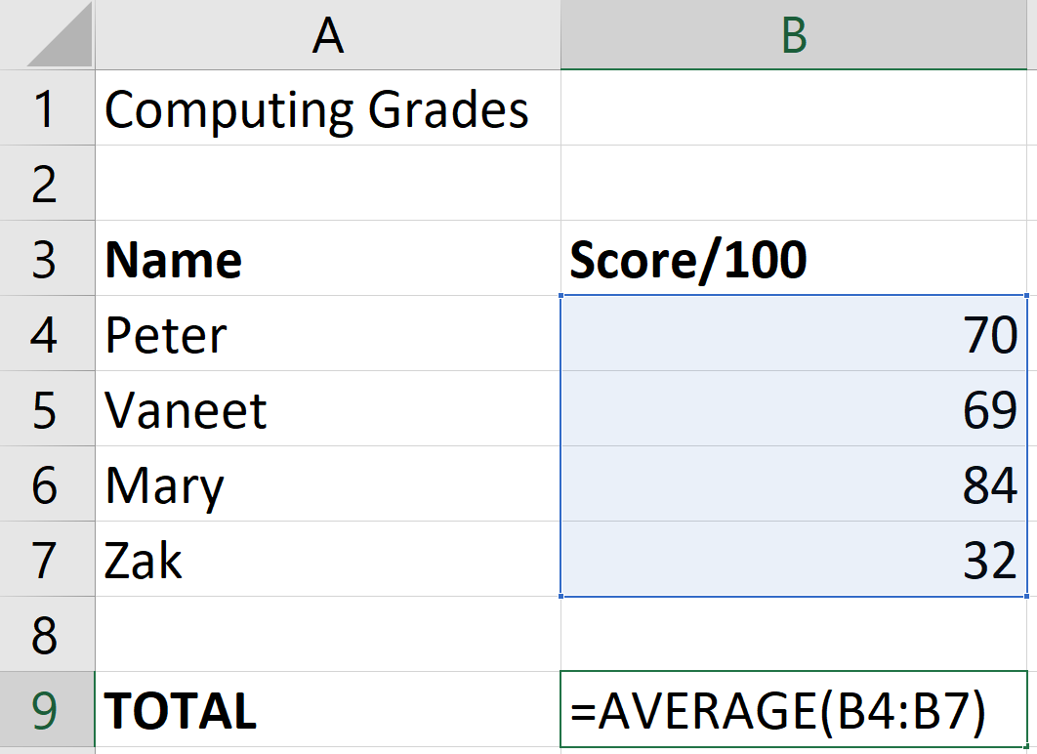
The AVERAGE function
Lesson 2: Functions using SUM, AVERAGE, MAX and MIN
The AVERAGE function works in much the same way as the SUM function.
To work out the average mark use the formula: =AVERAGE(B4:B7).
Now watch video 2.2

Slide 11
Activity 2.2: Using AVERAGE
Lesson 2: Functions using SUM, AVERAGE, MAX and MIN

Slide 12
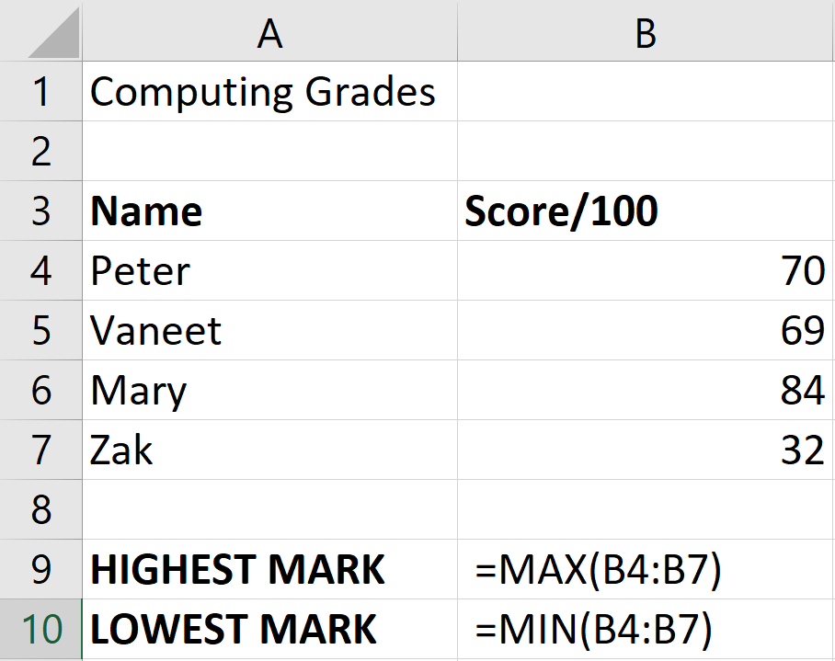
The MAX and MIN functions
Lesson 2: Functions using SUM, AVERAGE, MAX and MIN
To find the largest value in a range, use the MAX function.
The highest exam mark is found using the formula: =MAX(B4:B7).
To find the smallest value in a range, use the MIN function.
The lowest exam mark is found using the formula: =MIN(B4:B7).
Now watch video 2.3

Slide 13
Activity 2.3: Using MAX and MIN
Lesson 2: Functions using SUM, AVERAGE, MAX and MIN

Slide 14
Activity 2.4: Basic functions
Lesson 2: Functions using SUM, AVERAGE, MAX and MIN

Slide 15
Activity 2.5: Cinema tickets
Lesson 2: Functions using SUM, AVERAGE, MAX and MIN

Slide 16
Activity 2.6: Pocket money
Lesson 2: Functions using SUM, AVERAGE, MAX and MIN

Slide 17
Activity 2.7: Birthday Cake
Lesson 2: Functions using SUM, AVERAGE, MAX and MIN

